Slide 1
Testing
Unit Testing & JUnit

Slide 2
What is Unit Testing?
A procedure to validate individual units of Source Code
Example: A procedure, method or class
Validating each individual piece reduces errors when integrating the pieces together later

Slide 3
JUnit
A tool for test-driven development

Slide 4
Automated Unit Tests with JUnit
Junit is a simple, open source unit testing framework for Java
Allows you to write unit tests in Java using a simple interface
Automated testing enables running and rerunning tests very easily and quickly
Supported by www.junit.org

Slide 5
Unit Testing
Introduction to JUnit

Slide 6
Frameworks vs. Libraries
P2 — A Testing Framework
In traditional application architectures, user code makes use of library functionality in the form of procedures or classes:
A framework reverses the usual relationship between generic and application code. Frameworks provide both generic functionality and application architecture:
User Application
main()
Library classes
Framework classes
main()
User classes
Essentially, a framework says: “Don’t call me — I’ll call you.”
© O. Nierstrasz
3.<number>
Notes:
Framework - Gerüst, Rahmen oder Skelett. Darin wird ausgedruckt, dass ein Framework in der Regel eine Anwendungsarchitektur vorgibt. Da findet eine Umkehrung der Kontrolle statt. Der Programmierer registriert konkrete Implementierung, die dann durch das Framework gesteuert und benutzt werden, statt wie bei einer Klassenbibliothek, wo Klassen benutzt werden.

Slide 7
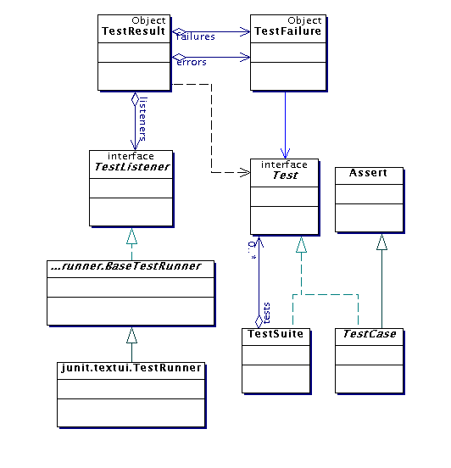
Architectural overview
JUnit test framework is a package of classes that lets you write tests for each method, then easily run those tests
TestRunner runs tests and reports TestResults
You test your class by extending abstract class
TestCase
To write test cases, you need to know and understand the
Assert class

Slide 8
JUnit Example
import org.junit.Test
import static org.junit.Assert.*;
public class CalcTest
{
@Test
public void testAdd()
{
int result = Calc.add(2,3);
assertEquals( 5, result);
}
}
public class Calc
{
static public int add (int a, int b)
{
return a + b;
}
}

Slide 9
Steps in unit tests (Junit)
1.Prepare (or setUp() ) environment conditions that must be met, according to the test plan. At this stage, define and set prefix values. Eg. instantiate objects, initialize fields, turn on logging, etc.
2. Execute the test case. This means, executing (exercising) the part of the code to be tested. For that we use some test inputs (test case values), according to the test plan.

Slide 10
3. Evaluate (or assert*()) the results, or side effects generated by the execution of the test case, against an expected value as defined in the test plan.
4. Clean up (or tearDown()) the test environment if needed so that further testing activities can be done, without being influenced by the previous test cases.

Slide 11
Test cases
SI no: | Test case name | Test Procedure | Pre condition | Expected Result | Reference to Detailed Design/ Spec Document
1. | fnEmployee_TRUE1 | Call the function fnEmployee with correct empid | With out phone number | Display the existing employee details and assign new phone number | fnEmployee

Slide 12
Step 1: Unit Testing with JUnit 4
1.Prepare (or setUp() ) the test environment:
- Annotate with @Before: Those methods are executed before
each test case (test method).
@Before
public void setUp() {
s = new Sample();
}

Slide 13
Step 4: Unit Testing with JUnit 4
Clean up (or tearDown()) the test environment is done in one or several methods that are run after execution of each test method.
A method has to be annotated with @After.
If you allocate external resources in a @Before method, you need to release them after the test runs.
@After
public void tearDown() {
s = null;
}

Slide 14
Step 2&3: Unit Testing with JUnit 4
@Test
public void testAddition( ) {
int a=3 , b=6;
int expectedOutput = (a+b);
int res = s.Addition(a, b);
assertEquals(expectedOutput, res);
}

Slide 15
Step 4: Unit Testing with JUnit 4
Clean up (or tearDown()) the test environment is done in one or several methods that are run after execution of each test method.
A method has to be annotated with @After.
If you allocate external resources in a @Before method, you need to release them after the test runs.
@After
public void tearDown() {
s = null;
}

Slide 16
Ignored Tests
Sometimes it’s useful to mark test to be ignored by test runner
  test that takes an excessively long time to run
  test that access remote network servers
  test is failing for reasons beyond your control
Such tests can be annotated as @Ignore
@Ignored
@Test public void myTest() {
}

Slide 17
Timed Tests
In JUnit 4 tests can be annotated with a timeout parameter
If the test takes longer than the specified number of milliseconds to run, the test fails
@Test(timeout=500)
public void retrieveAllElementsInDocument() {
doc.query("//*");
}

Slide 18
Junit with Netbeans
1. Create the Java Project
2. Create the Java Class
3. Create a Test Class for Java Class
4. Write Test Methods for Test Class
5. Run the Test
6. Create Test Suite (optional)

Slide 19
Create Test class for Java class
Right-click Myclass.java > choose Tools > Create/Update Tests.
Select JUnit in the Framework dropdown list.

Slide 20
Test Execution
Execute a test by using the Run function of the IDE.
NetBeans/Eclipse, can use a default test runner-- all the tests in the class run one by one.

Slide 21
Status of a Test
A test is a single run of a test method.
Success : A test succeeds in time when No assert is violated; No fail statement is reached; No unexpected exception is thrown.
Failure: A test fails when an assert is violated or a fail statement is reached.
Error: An unexpected exception is thrown or timeout happens.

Slide 22
Assert methods
Within a test,
  Call the method being tested and get the actual result
  Assert what the correct result should be with one of the assert methods
  These steps can be repeated as many times as necessary
An assert method is a JUnit method that performs a test, and throws an AssertionError if the test fails
  JUnit catches these Errors and shows you the result
static void assertTrue(boolean test)
static void assertTrue(String message, boolean test)
  Throws an AssertionErrorif the test fails
  The optional message is included in the Error
static void assertFalse(boolean test)
static void assertFalse(String message, boolean test)
  Throws an AssertionErrorif the test fails

Slide 23
Assert methods
Each assert method has parameters like these:
message, expected-value, actual-value
Assert methods dealing with floating point numbers get an additional argument, a tolerance
Each assert method has an equivalent version that does not take a message – however, this use is not recommended because:
  messages helps to documents the test reports.
  messages provide additional information when reading failure logs

Slide 24
junit.framework.Assert
Provide static methods which can help comparing the expectedresult and actual result.
If any assert is violated, a failure will be recorded.
assertEquals (expected, actual)
assertSame (expected,actual)
assertNotSame (unexpected, actual)
assertFalse (condition)
assertTrue (condition)
assertNotNull (object)
assertNull (object)
fail ()
assertEquals (message, expected, actual)
assertSame (message, expected, actual)
assertNotSame (message, unexpected, actual)
assertFalse (message, condition)
assertTrue (message, condition)
assertNotNull (message, object)
assertNull (message, object)
fail (message)

Slide 25
Test Suite
A collection of of test cases/classes executed together
test suite
test runner
another unit test
A unit test tests the methods in a single class
A test case tests (insofar as possible) a single method
You can have multiple test cases for a single method
A test suite combines unit tests
The test fixture provides software support for all this
The test runner runs unit tests or an entire test suite
Integration testing (testing that it all works together) is not well supported by JUnit
test case (for one method)
another test case
another unit test
another test case
another test case
another test case
unit test (for one class)
test case (for one method)
another test case

Slide 26
DEMO
Junit with NetBeans

Slide 27
Make a simple class name (SimpleMath.java)that has the following methods:
Addition
Subtraction
Multiplication
Create the test class for these method

Slide 28
1. Create the Java Project
Launch NetBeans
File New Project

Slide 29
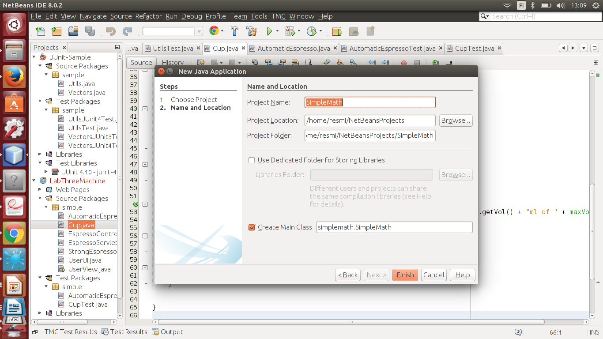

Slide 30
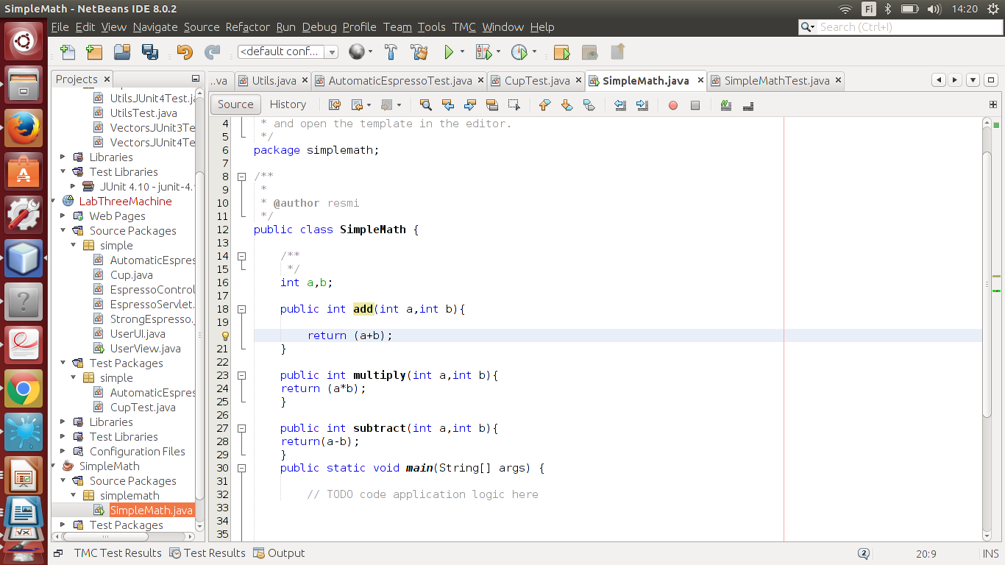
The Java Class

Slide 31
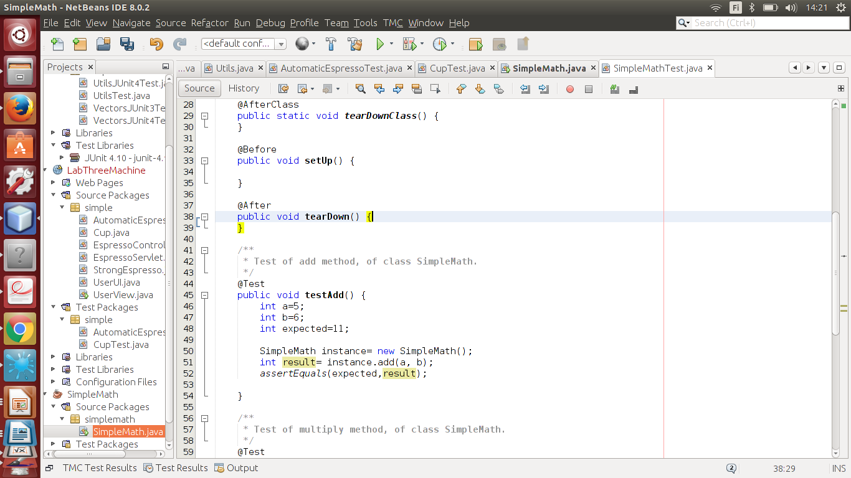
The Test Class

Slide 32
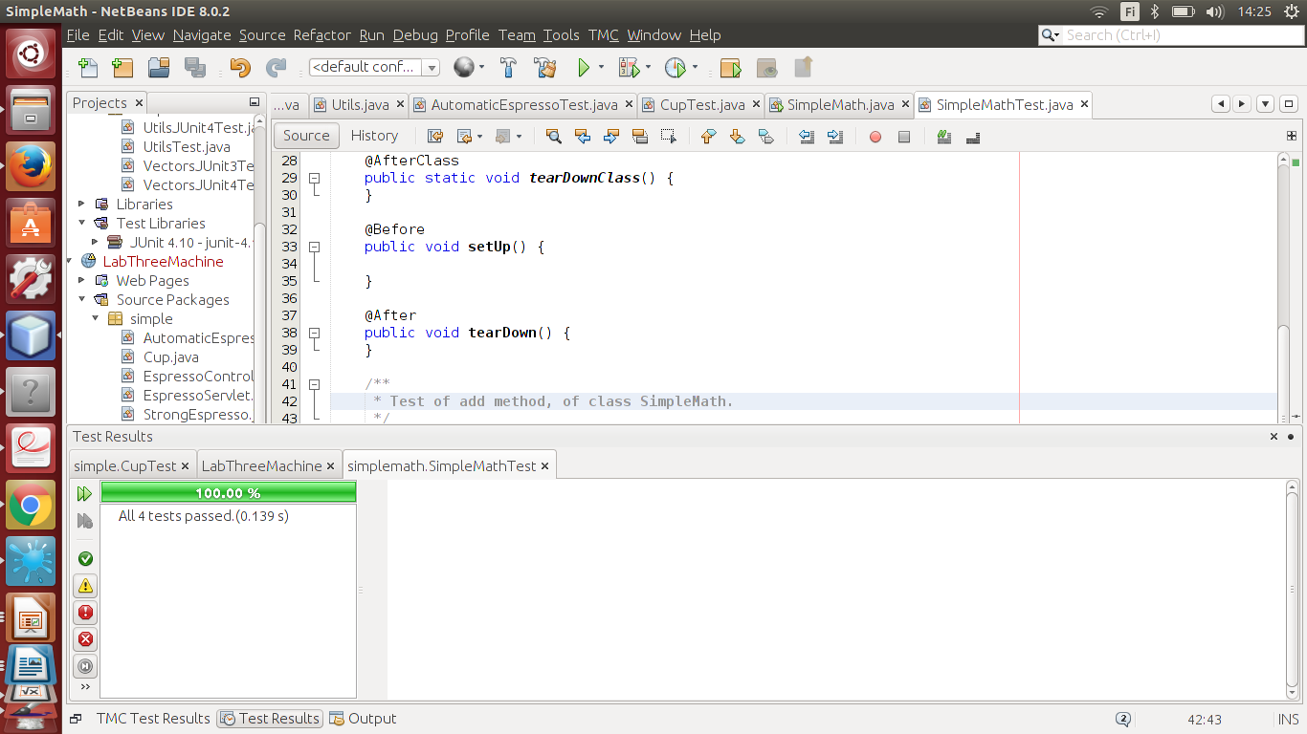
Execution Results

Slide 33
Test Report
Sl No | Test case name | Test Procedure | Pre condition | Expected Result | Reference to Detailed Design/ Spec Document
1 | fnDeptcode_TRUE | call fnDepartment with correct deptcode | Department table & Employee Table is not empty | Display the details of the department form the table department and find the total number of employees working in that dept from Employee Table | fnDepartment, fnEmployee
2 | fnDeptcode_FALSE | call fnDepartment with incorrect deptcode | Department table is not empty | Display error message | FnDepartment,
3 | fnEmpcode_TRUE | call fnEmpdetails with correct empid | Employee table conatain telephone number | Display the details of the employee with telephone number | fnEmpdetails
4 | fnEmpcode_FALSE | call fnEmpdetails with incorrect empid | Employee table is not empty | Display error messages | fnEmpdetails
5 | fnEmpcode_tnum_FALSE | call fnEmpdetails with correct empid | Employee doesn't have a telephone number | Display error messages | fnEmpdetails

